Slide 1
NATURAL
VERSUS
SYNTHETIC
CORNEA REPLACEMENT METHODS

Slide 2
TABLE OF CONTENTS
01
02
03
04
05
06
CAUSES OF CORNEA DAMAGE & CHALLENGES IN REPLACEMENTS
STRUCTURE AND FUNCTION OF THE CORNEA
TIMELINE OF CORNEA REPLACEMENT METHODS
NATURAL
METHODS
SYNTHETIC METHODS
INCLUSIVITY
&
SUSTAINABILITY

Slide 3
01
STRUCTURE AND FUNCTION OF THE CORNEA

Slide 4

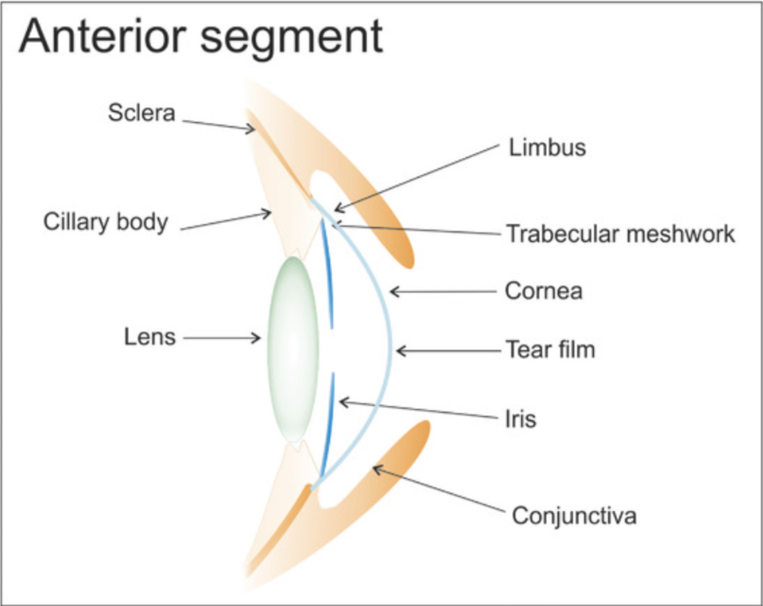


Image taken from Williams et al., 2018.

Slide 5
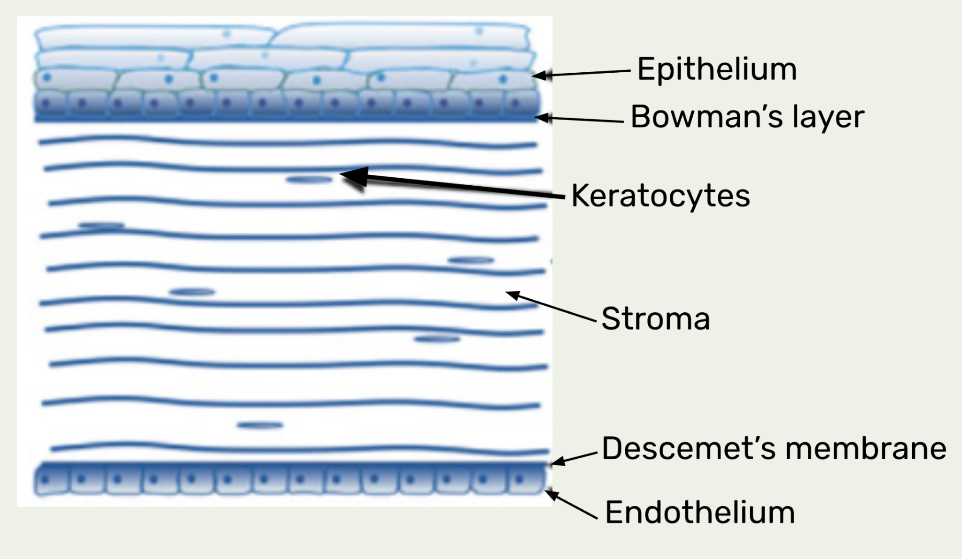
Image adapted from Williams et al., 2018.

Slide 6
02
CAUSES OF CORNEA DAMAGE &
CHALLENGES IN PRODUCING REPLACEMENTS

Slide 7
COMMON CAUSES OF CORNEAL DAMAGE
01
INFECTIONS
TRAUMA
02
CORNEAL DISEASES
03

Slide 8
CHALLENGES IN PRODUCING CORNEAL REPLACEMENTS
COMPLEX STRUCTURE
INTEGRATION
SURGICAL TECHNIQUES
CELL SOURCES
COST AND ACCESSIBILITY

Slide 9
03
CORNEA DEVELOPMENT TIMELINE

Slide 10
2004
First Descemet Stripping & Membrane Endothelial Keratoplasty
2006
Microkeratome for Donor Dissection: DSAEK Gorovoy
1905
First full corneal transplant performed by Zirm
1945
First eye bank is established
1900 - 1950
EARLY 2000s
BEFORE 1900s
1950 - 2000
CURRENTLY
1968
First Boston Keratoprosthesis
1998
First posterior Lamellar Keratoplasty performed by Melles
2018
Cell based therapies are being developed by Kinoshita et al.
1789
First keratoprosthesis design by Pellier de Quengsy

Slide 11
04
NATURAL CORNEAL REPLACEMENT METHODS

Slide 12

CRITERIA
Due to a shortage in allografts, the development of engineered corneal constructs or scaffolds for the repair of corneal damage is potentially vital.
The primary properties required of a natural material in the replacement of damaged corneal tissue include:
SUITABLE MECHANICAL STRENGTH
BIOCOMPATIBILITY
TRANSPARENCY
BIODEGRADABILITY
CLINICAL COMPLIANCE
Notes:
Transparency may be before or after transplantation
Scaffold material is very important factor in the success of a tissue engineered construct because its properties will influence the response of cells cultured on or within the scaffold

Slide 13
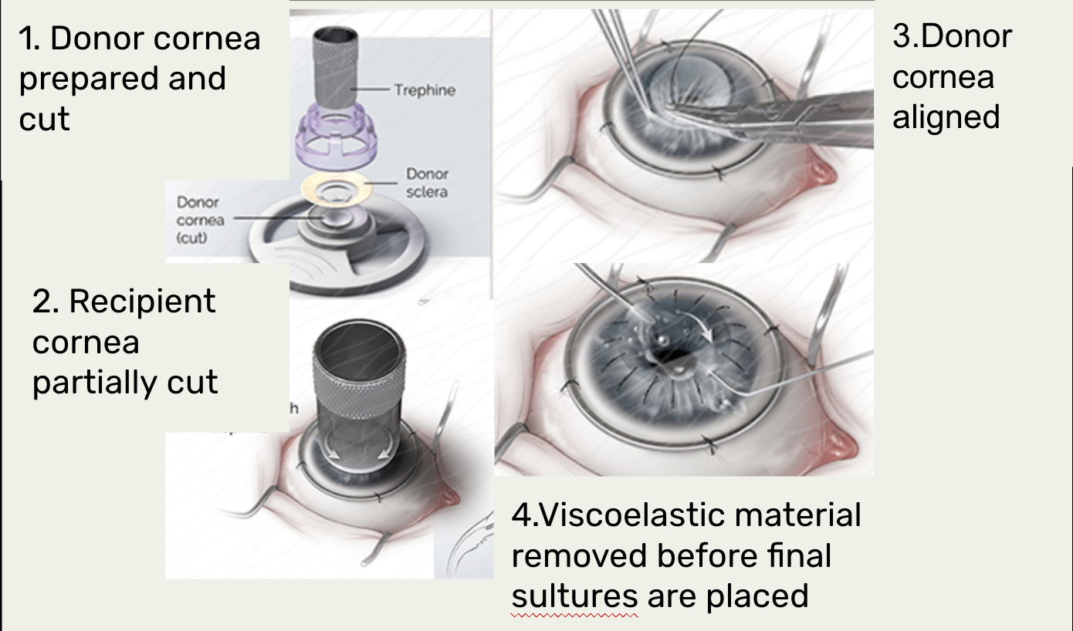
CURRENT TREATMENT
PENETRATING KERATOPLASTY
Current standard treatment is transplantation of allogeneic materials originating from human donor tissue
Problems with this practice:
Rates for graft rejection as high as 50%
Tissue rejection process can potentially lead to permanent blindness
Low supply of human donor tissue
Image adapted from https://meetingarchive.ami.org/2017/project/keratoplasty/

Slide 14
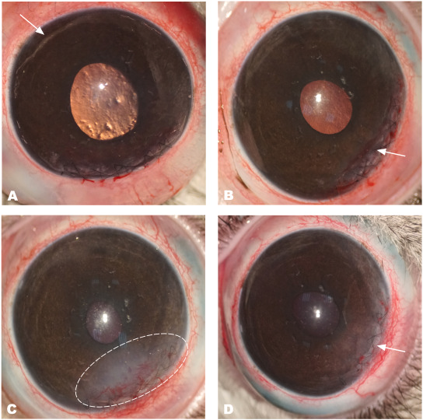
NATURAL MATERIALS
COLLAGEN HYDROGELS
Study:
Photographs of collagen membranes implanted into the corneal stroma of a rabbit.
Key component in tendons and ligaments
Relatively cheap to derive
Compatible with all corneal cells and nerve regrowth in vivo
Biodegradable
Lacks mechanical strength
Lacks elasticity
Often crosslinked with other materials to improve mechanical strength and chemical stability without compromising its biological advantages
Example: Collagen-chitosan hydrogel
Notes:
Collagen-chitosan hydrogels
Chitin (long chain polymer formed from glucose, found naturally in arthropod exoskeletons and fungal cell walls) - converted into chitosan by deacetylation
Chitosan is biodegradable biocompatible and non-toxic - widely used in tissue engineering for drug delivery systems, has been researched as a replacement for AM as a scaffold for corneal surface and endothelial reconstruction, however its hydrophilic nature and low stability considerably restrict its use
Chitosan combined with collagen to reduce its weaknesses, cross linked with EDC - improved hydrophilicity and transparency
No clinical trials completed yet

Slide 15
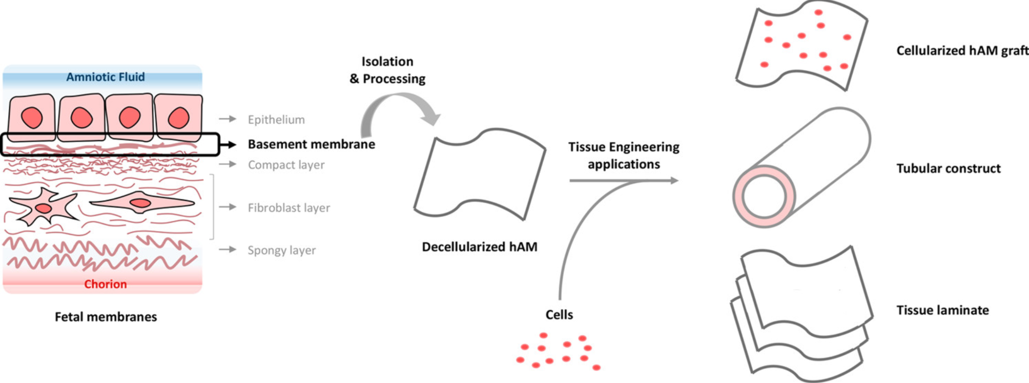
NATURAL MATERIALS
HUMAN AMNIOTIC MEMBRANE
Similar structure to corneal epithelium
Lacks complete transparency
Lacks mechanical strength
Folds easily when handled
Must undergo extensive and expensive testing
Image taken from (Arrizabalaga and Nollert, 2018)
Notes:
AM = innermost layer of placenta
Mention that some FDA approved AM products are already commercially available - shows a considerable amount of research and successful trials to support the use of AM

Slide 16
05
SYNTHETIC CORNEAL REPLACEMENT METHODS
(KERATOPROSTHESIS)

Slide 17
COMMERCIAL TRANSPLANT METHODS
BOSTON TYPE 1
ALPHACORTM
Most used keratoprosthesis currently
Optical stem and skirt made of PMMA and titanium
Still requires donor tissue
Short term recovery is quick
Long term usage has brought various complications such as glaucoma and endophthalmitis
Made entirely from PHEMA
Made of a central optic region surrounded by a macroporous skirt
Fused together by an interpenetrating polymer network
High - end surgery procedure
Fewer post - surgery complications
Less used currently

Slide 18
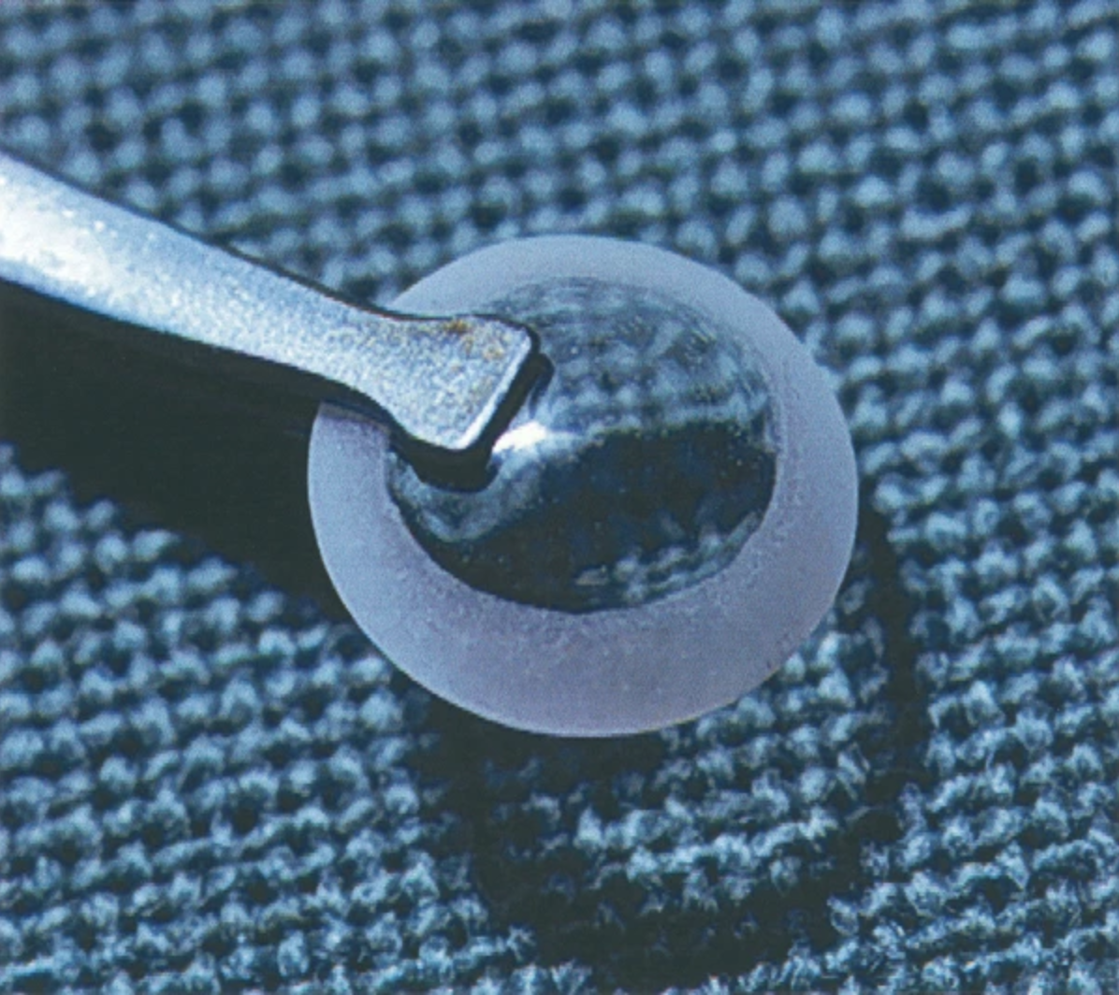
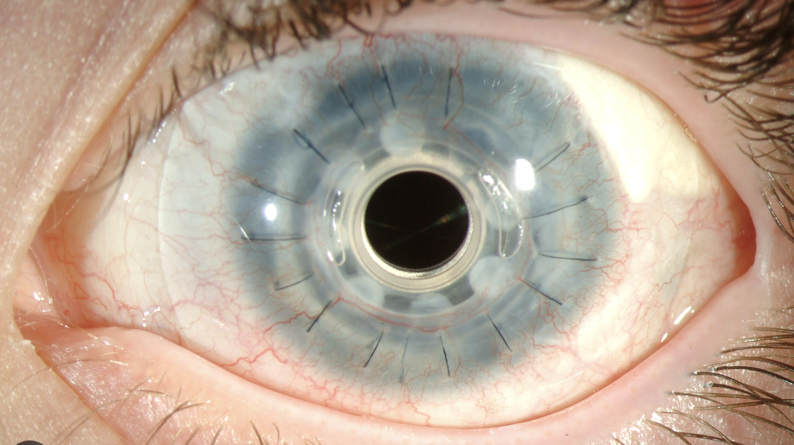
COMMERCIAL TRANSPLANT METHODS
BOSTON TYPE 1
ALPHACORTM
Image taken from: https://webeye.ophth.uiowa.edu/eyeforum/tutorials/cornea-transplant-intro/6-kprosth.htm
Image taken from Hicks et al., 2003

Slide 19
EXPERIMENTAL TRANSPLANT METHODS
COPOLYMERIC SCAFFOLD OF PHEMA & PMMA
SYNTHETIC HYDROGELS
A substrate of poly - ε - lysine cross - linked with octanedioic acid hydrogel for the expansion of corneal endothelial cells
Easy and rapid manufacturing process
Relatively inexpensive reagents
Non toxic
Can be cast in contact - lens moulds
Good transparency across all wavelengths of visible light
A transparent PHEMA cylinder and a porous PHEMA - PMMA skirt which allows:
Light to get in
cell penetration for tissue integration
Simultaneously permits vision and cell growth
Successful in resisting rupture and separation

Slide 20
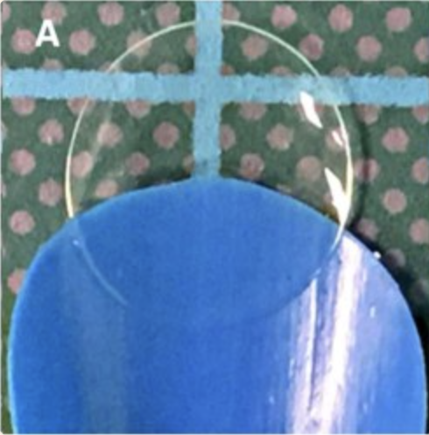
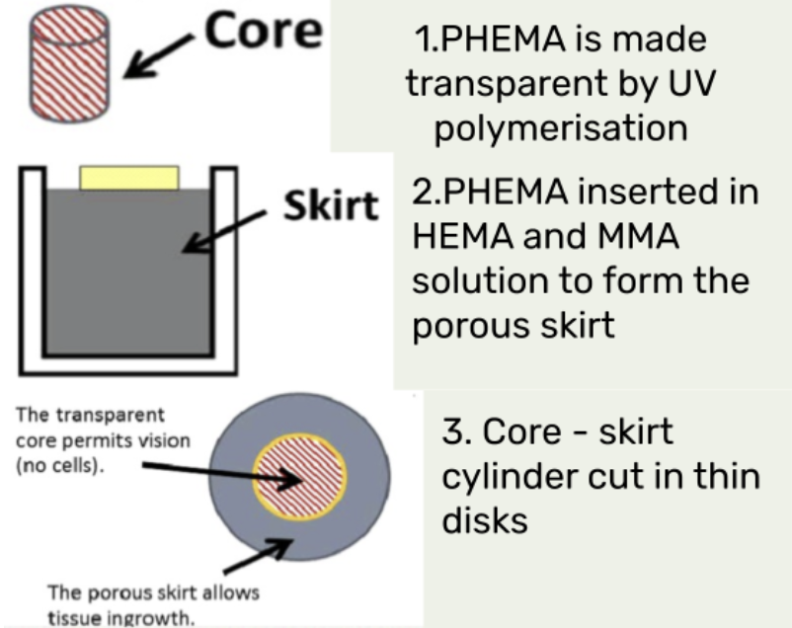
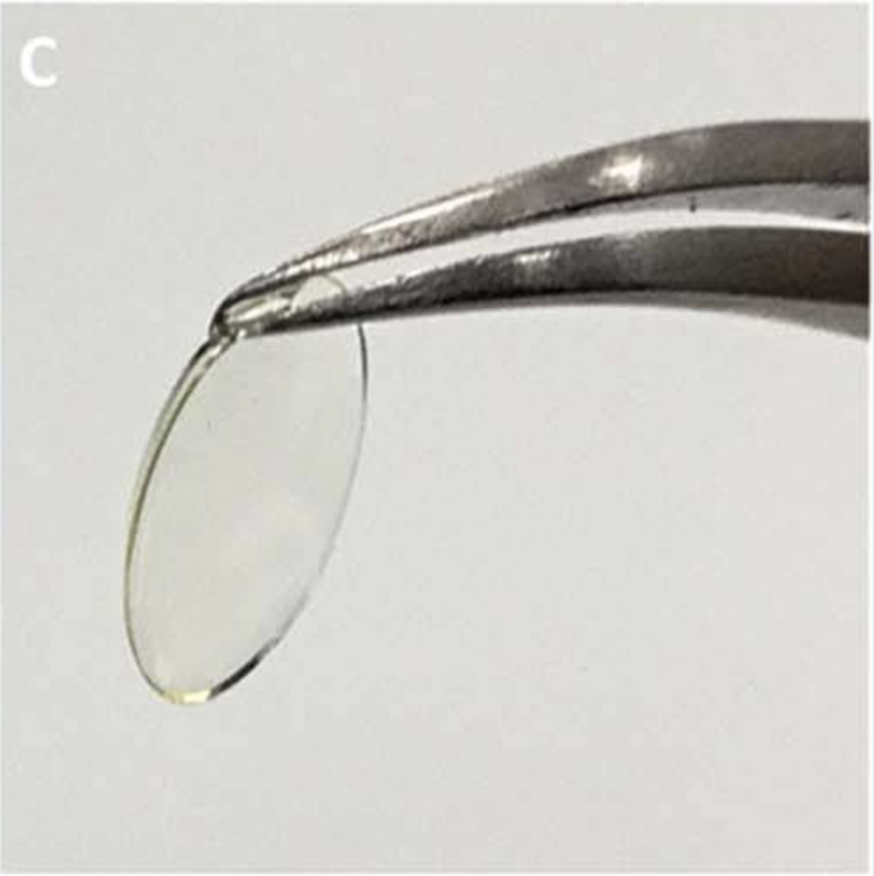
EXPERIMENTAL TRANSPLANT METHODS
COPOLYMERIC SCAFFOLD OF PHEMA & PMMA
SYNTHETIC HYDROGELS
Image adapted from: Zellander et al., 2013
Images taken from Kennedy et al., 2019.

Slide 21
06
INCLUSIVITY
AND
SUSTAINABILITY

Slide 22
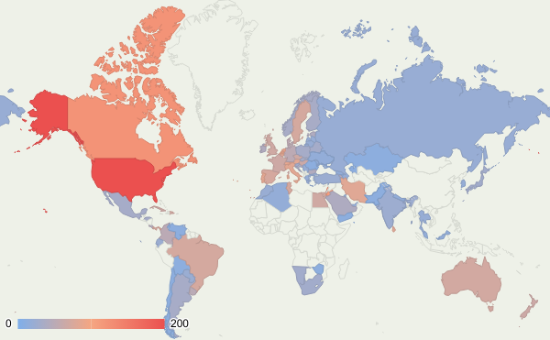
DISTRIBUTION OF CORNEAL TRANSPLANTS PER CAPITA
UNITED STATES
200 corneas transplanted per capita
BRAZIL
72 corneas transplanted per capita
INDIA
25 corneas transplanted per capita
Data adapted from the following source: https://jamanetwork.com/journals/jamaophthalmology/fullarticle/2474372

Slide 23
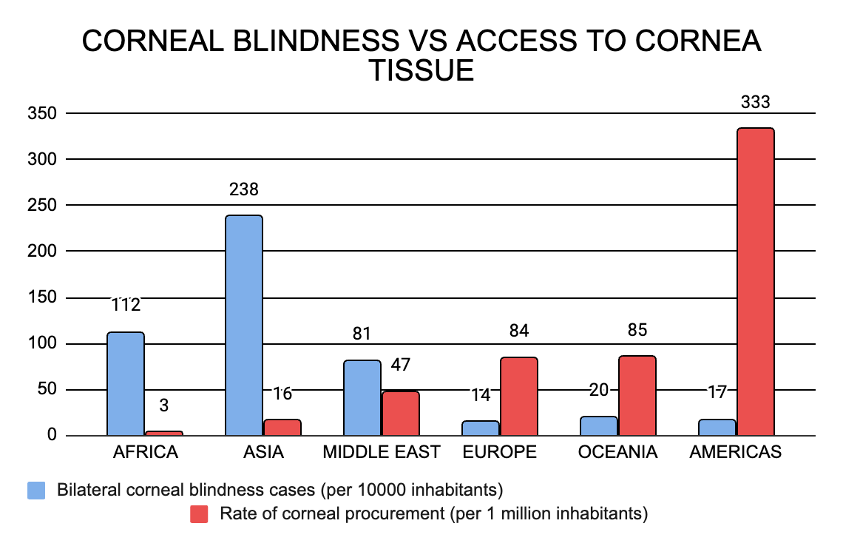

Slide 24
OVERCOMING THE INCLUSIVITY BIAS
COST REDUCTION STRATEGIES
PRESERVABILITY & MAXIMISATION
NON PROFIT ORGANISATIONS
Tissue-engineered endothelial keratoplasty
Donor Tissue
Irradiating tissue: 2 years of preservation at room temperature.
Lamellar/split-cornea transplantation
Subsidized programs and global initiatives for economically disadvantaged areas
VS
$880
$3170
TELEMEDICINE
MEDICAL TRAINING
PREVENTATIVE MEDICINE
Preoperative consultations allows remote area access
Improving the economy, medical accessibility and community
Nearly 80% of corneal blindness is avoidable

Slide 25
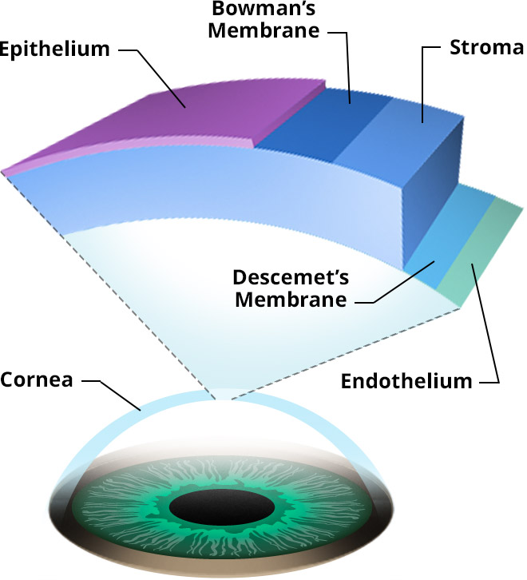
KEY NUMBERS
89%
21.7%
ANTERIOR PORTION
NATIONALLY PRODUCED
POSTERIOR PORTION
NATIONALLY PRODUCED & IMPORTED

Slide 26

SUSTAINABILITY (NATURAL METHODS)
BIODEGRADABLE MATERIALS
IMMUNE PRIVILEGE
（relative to other organ grafts)
-Collagen
-Amniotic membrane
Lacks blood/lymphatic vessels makes it harder for immune system to access cornea
EQUIPMENT
INCINERATION OF UNUSED CORNEAL GRAFTS
sterilised and stored at specific temperatures and conditions
High rates of carbon footprint and emission of greenhouse gases

Slide 27
SUSTAINABILITY (SYNTHETIC METHODS)
PROCEDURE | MATERIALS | COST (USD)
BOSTON TYPE I | PMMA & TITANIUM | PMMA: $3.56/kg TITANIUM: $49/kg
COPOLYMERIC SCAFFOLD OF PHEMA & PMMA | PHEMA(hydrogel) & PMMA | PHEMA:$20/g PMMA: $3.56/kg
ALPHACOR | PHEMA | PHEMA:$20/g

Slide 28
WAYS TO MAKE PROCEDURES MORE SUSTAINABLE
DEVELOP MORE SUSTAINABLE POLYMERS
XENOTRANSPLANTATION
SOURCE MATERIALS LOCALLY
Transplantation of cornea from animals with similar corneal structure to humans
Reduce transport costs/greenhouse gases
Source materials from bio-based feedstock/natural polymers
UTILISE TELEMEDICINE
PACKAGING
USE RENEWABLE ENERGY SOURCES
Reduce the need for donors to travel to healthcare facilities
Usage of biodegradable materials
(PLA)
Mitigate environmental effects

Slide 29
CONCLUSION
Natural materials incorporated with synthetic methods to give us the flexibility to pick and choose the properties of the biomaterials.
The current scientific developments are directed mainly towards synthetic scaffolds in which the patient's own tissue can grow and integrate better with the rest of the eye whilst acting as a cornea
Synthetic polymers allow for customisation of desired properties and they can be manufactured for the relevant applications.

Slide 30
REFERENCES
CORNEA DAMAGE & CHALLENGES AND NATURAL TRANSPLANT METHODS
Holland, G. et al. (2021) Artificial Cornea: Past, current, and Future Directions, Frontiers. Available at: https://www.frontiersin.org/articles/10.3389/fmed.2021.770780/full (Accessed: 07 November 2023).
Themes, U. (2020) Section I reconstructing the cornea, Ento Key. Available at: https://entokey.com/section-i-reconstructing-the-cornea-6/ (Accessed: 07 November 2023).
Corneal conditions (no date) National Eye Institute. Available at: https://www.nei.nih.gov/learn-about-eye- health/eye-
conditions-and-diseases/corneal-conditions (Accessed: 30 November 2023).
Jameson JF, Pacheco MO, Nguyen HH, Phelps EA, Stoppel WL. Recent Advances in Natural Materials for Corneal Tissue Engineering. Bioengineering (Basel). 2021 Oct 26;8(11):161. doi: 10.3390/bioengineering8110161. PMID: 34821727; PMCID: PMC8615221.
Ghezzi CE, Rnjak-Kovacina J, Kaplan DL. Corneal tissue engineering: recent advances and future perspectives. Tissue Eng Part B Rev. 2015 Jun;21(3):278-87. doi: 10.1089/ten.TEB.2014.0397. Epub 2015 Feb 10. PMID: 25434371; PMCID: PMC4442593.
Palchesko RN, Carrasquilla SD, Feinberg AW. Natural Biomaterials for Corneal Tissue Engineering, Repair, and Regeneration. Adv Healthc Mater. 2018 Aug;7(16):e1701434. doi: 10.1002/adhm.201701434. Epub 2018 May 29. PMID: 29845780.
Andreev AY, Osidak EO, Grigoriev TE, Krasheninnikov SV, Zaharov VD, Zaraitianc OV, Borzenok SA, Domogatsky SP. A new collagen scaffold for the improvement of corneal biomechanical properties in a rabbit model. Exp Eye Res. 2021 Jun;207:108580. doi: 10.1016/j.exer.2021.108580. Epub 2021 Apr 17. PMID: 33872673.
Gurnani B, Kaur K. Penetrating Keratoplasty. [Updated 2023 Jun 11]. In: StatPearls [Internet]. Treasure Island (FL): StatPearls Publishing; 2023 Jan-. Available from: https://www.ncbi.nlm.nih.gov/books/NBK592388/
Chen, Z., You, J., Liu, X., Cooper, S., Hodge, C., Sutton, G., Crook, J.M. and Wallace, G.G. (2018). Biomaterials for corneal bioengineering. Biomedical Materials, 13(3), p.032002. doi:https://doi.org/10.1088/1748-605x/aa92d2.

Slide 31
REFERENCES
CORNEA STRUCTURE & SYNTHETIC CORNEA TRANSPLANT METHODS
Ghezzi, C.E., Rnjak-Kovacina, J. and Kaplan, D.L. (2015). Corneal Tissue Engineering: Recent Advances and Future Perspectives. Tissue Engineering Part B: Reviews, 21(3), pp.278–287. doi:https://doi.org/10.1089/ten.teb.2014.0397.
Soleimani, M., Ebrahimi, Z., Kosar Sadat Ebrahimi, Negin Farhadian, Mohsen Shahlaei, Kasra Cheraqpour, Ghasemi, H., Moradi, S., Chang, A., Sharifi, R., Seyed Mahbod Baharnoori and Djalilian, A.R. (2023). Application of biomaterials and nanotechnology in corneal tissue engineering. Journal of International Medical Research, [online] 51(7). doi:https://doi.org/10.1177/03000605231190473.
‌Uiowa.edu. (2016). Keratoprosthesis. [online] Available at: https://webeye.ophth.uiowa.edu/eyeforum/tutorials/Cornea-Transplant-Intro/6-kprosth.htm.
‌Hicks, C.R., Crawford, G.J., Lou, X., Tan, D.T., Snibson, G.R., Sutton, G., Downie, N., Werner, L., Chirila, T.V. and Constable, I.J. (2003). Corneal replacement using a synthetic hydrogel cornea, AlphaCorTM: device, preliminary outcomes and complications. Eye, 17(3), pp.385–392. doi:https://doi.org/10.1038/sj.eye.6700333.
Tan, X.W., Perera, A.P.P., Tan, A., Tan, D., Khor, K.A., Beuerman, R.W. and Mehta, J.S. (2011). Comparison of Candidate Materials for a Synthetic Osteo-Odonto Keratoprosthesis Device. Investigative Opthalmology & Visual Science, 52(1), p.21. doi:https://doi.org/10.1167/iovs.10-6186.
Zellander, A., Wardlow, M., Djalilian, A.R., Zhao, C., Abiade, J.T. and Cho, M. (2013). Engineering copolymeric artificial cornea with salt porogen. Journal of Biomedical Materials Research Part A, 102(6), pp.1799–1808. doi:https://doi.org/10.1002/jbm.a.34852.

Slide 32
REFERENCES
CORNEA STRUCTURE & SYNTHETIC AND NATURAL CORNEA TRANSPLANT METHODS
Williams, R., Lace, R., Kennedy, S., Doherty, K. and Levis, H. (2018). Biomaterials for Regenerative Medicine Approaches for the Anterior Segment of the Eye. Advanced Healthcare Materials, 7(10), p.1701328. doi:https://doi.org/10.1002/adhm.201701328.
Hertsenberg, A.J. and Funderburgh, J.L. (2015). Chapter Three - Stem Cells in the Cornea. [online] ScienceDirect. Available at: https://www.sciencedirect.com/science/article/abs/pii/S1877117315000630.
Forrester, J.V., Dick, A.D., McMenamin, P.G., Roberts, F. and Pearlman, E. (2016). Anatomy of the eye and orbit. The Eye, pp.1-102.e2. doi:https://doi.org/10.1016/b978-0-7020-5554-6.00001-0.
‌PMMA. (n.d.). PMMA & Science. [online] Available at: https://www.pmma-online.eu/pmma-science/#:~:text=What%20is%20it%20made%20of.
Kennedy, S., Lace, R., Carserides, C., Gallagher, A.G., Wellings, D.A., Williams, R.L. and Levis, H.J. (2019). Poly-ε-lysine based hydrogels as synthetic substrates for the expansion of corneal endothelial cells for transplantation. Journal of Materials Science: Materials in Medicine, 30(9). doi:https://doi.org/10.1007/s10856-019-6303-1.
‌CRSToday. (n.d.). The Alphacor Artificial Cornea. [online] Available at: https://crstoday.com/articles/2005-jan/0105_f9_hardten-html [Accessed 13 Dec. 2023].
Arrizabalaga, J.H. and Nollert, M.U. (2018). Human Amniotic Membrane: A Versatile Scaffold for Tissue Engineering. ACS Biomaterials Science & Engineering, 4(7), pp.2226–2236. doi:https://doi.org/10.1021/acsbiomaterials.8b00015.

Slide 33
REFERENCES
INCLUSIVITY & SUSTAINABILITY
Philippe Gain, MD, PhD^{1,2}; Rémy Jullienne, MD¹; Zhiguo He, PhD (2016). Global Survey of Corneal Transplantation and Eye Banking, JAMA Ophthalmol
Fanny Ricourd (2019). Regional trends in corneal transplantation from 2004 to 2015 in France: a 12-year review on indications, technique and waiting period, Springer Link
Tien-En Tan ,Gary S. L. Peh(2014). A Cost-Minimization Analysis of Tissue-Engineered Constructs for Corneal Endothelial Transplantation, Plos Journal
Tauber, Shachar MD; Bowman, John BS (2012).Precise Temperature Control of Donor Cornea Tissue With Reusable Passive Thermal Container, Cornea
Bennie H. Jeng, MD, Samera Ahmed, MD (2020).In Pursuit of the Elimination of Corneal Blindness: Is Establishing Eye Banks and Training Surgeons Enough?,Opthamology
World Heath Organization (2023). Blindness and vision impairment
Catherine Liu, Hajirah N. Saeed (2022), Disparities in Access to Corneal Tissue in the Developing World, Taylor&Francis
Qazi, Y. and Hamrah, P. (2013). Corneal Allograft Rejection: Immunopathogenesis to Therapeutics. Journal of clinical & cellular immunology, [online] 2013(Suppl 9), p.006. doi:https://doi.org/10.4172/2155-9899.S9-006.
‌Shibru, M.G., Ali, Z.M., Alali, S., Hessa Alkhoori and Corridon, P.R. (2023). Keeping an eye on sustainable regeneration. Regenerative Medicine. doi:https://doi.org/10.2217/rme-2023-0142.
Salvador-Culla, B. and Kolovou, P.E. (2016). Keratoprosthesis: A Review of Recent Advances in the Field. Journal of Functional Biomaterials, [online] 7(2). doi:https://doi.org/10.3390/jfb7020013.
‌Poly(2-Hydroxyethyl Methacrylate) Hydrogels for Contact Lens Applications–A Review. (2021). Makara Journal of Science, 25(3). doi:https://doi.org/10.7454/mss.v25i3.1237

Slide 34
THANK YOU!

